Slide 1
Trail Version
Trail Version
Trail Version
Trail Version
Trail Version
Trail Version
Trail Version
Trail Version
Trail Version
Trail Version
Trail Version
Trail Version
Trail Version

Slide 2
1
Introduction to MATLAB®
MATLAB® is a high-level technical computing language and interactive environment for algorithm
development, data visualization, data analysis, and numerical computation. MATLAB is one of
a number of commercially available, sophisticated mathematical computation tools, which also
include Maple, Mathematica, and MathCad. The name MATLAB stands for MATrix LABoratory,
because its basic data element is a matrix (Array). MATLAB contains a large number of functions
that access proven numerical libraries, such as LINPACK and EISPACK. In fact, MATLAB has
many built-in tools for solving problems and developing graphical illustrations. This means that
many common tasks can be accomplished with a single function call. MATLAB was originally writ-
ten in FORTRAN and later rewritten in C, a precursor of C++. The beauty of MATLAB is that we
need to know only a tiny bit to get going and be productive. Once we get started, we can pick up new
skills quickly with MATLAB’s excellent online help features. MATLAB is optimized for matrices.
Thus, if a problem can be formulated with a matrix solution, MATLAB executes substantially faster
than a similar program in a high-level language.
1.1 STARTING MATLAB®
Trail Version
Trail Version
Trail Version
Trail Version
Trail Version
Trail Version
Trail Version
Trail Version
Trail Version
Trail Version
Trail Version
Trail Version
Trail Version
You can start MATLAB as you would any other software application. In Windows, you access it via
the Start menu. Alternatively, you may have a desktop icon that enables you to start MATLAB with
a simple double-click. When the MATLAB is started, a window opens in which the main part is the
Command Window. Figure 1.1 contains an example of a newly launched MATLAB desktop. In the
Command Window, you will see the prompt (>>). If the Command Window is active, the prompt
will be followed by a cursor. That is the place where you will enter MATLAB commands. If the
Command Window is not active, just click in it anywhere.
In addition to the Command Window, there are a couple of other windows that may be opened by
default. The layout can always be customized. To the left of the Command Window is the Current
Folder Window. The folder that is set as the Current Folder Window is where ﬁles will be saved.
This window shows the ﬁles that are stored in the Current Folder. To the right of the Command
Window are the Workspace Window on top and the Command History Window on the bottom. The
Command History Window shows commands that have been entered. The conﬁguration of each
window can be altered by clicking the down arrow at the top right corner of the window. This will
show a menu of options including closing and undocking that window. Alternatively, hitting the
down arrow under Layout in the “HOME” tab allows for the customization of the window within
the desktop environment as shown in Figure 1.2.
1.1.1 EntEring Commands in thE Command WindoW
Click in the Command Window to make it active. When a window becomes active, its title bar
darkens and a blinking cursor appears after the prompt. Now you can begin entering commands. Try
typing a = [2 4 7]and press the Enter or Return key:
>> a = [2 4 7]
a =
2
4
7
1

Slide 3
Trail Version
Trail Version
Trail Version
Trail Version
Trail Version
Trail Version
Trail Version
Trail Version
Trail Version
Trail Version
Trail Version
Trail Version
Trail Version

Slide 4
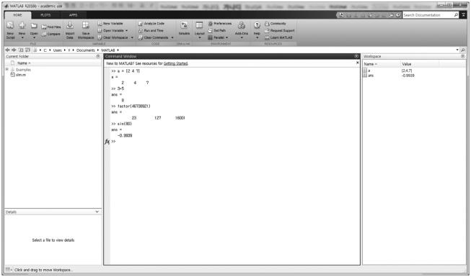
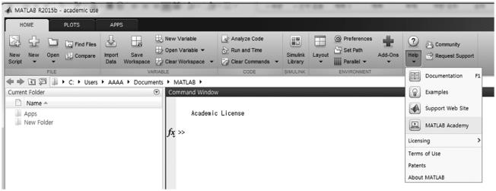
Introduction to MATLAB®
3
FIGURE 1.3 MATLAB® desktop with several commands evaluated.
• You can type help topicto access online help on the command, function, or symbol
topic.
• If you press the tab key after partially typing a function or variable name, MATLAB will
attempt to complete it, offering you a selection of choices if there is more than one possible
completion.
• MATLAB uses parentheses (), square brackets [], and curly braces {}, and these are not
interchangeable.
• You can quit MATLAB by typing exit or quit or click the x icon ( ) located at the upper
right corner of the MATLAB window.
Trail Version
Trail Version
Trail Version
Trail Version
Trail Version
Trail Version
Trail Version
Trail Version
Trail Version
Trail Version
Trail Version
Trail Version
Trail Version
1.1.2 hElp Command
The helpcommand can be used to identify MATLAB functions and also how to use them. To
ﬁnd out what a particular function or command does and how to call it, type helpand then the
name of the function or command. The explanations appear immediately in the Command Window.
Alternatively, hitting the down arrow under Help on the toolstrip of the Resources group of the desk-
top “HOME” tab allows for choice of various options as shown in Figure 1.4.
FIGURE 1.4 Submenus of the Help tab.

Slide 5
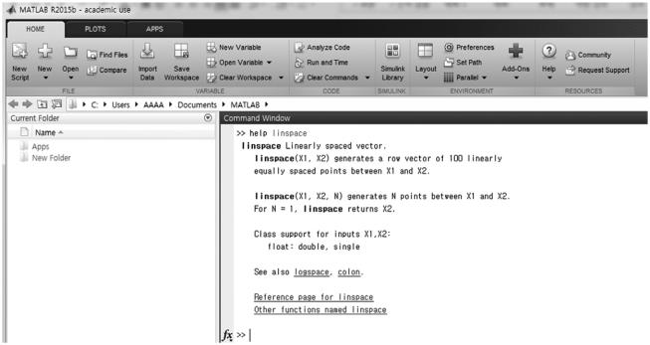
4
Chemical Engineering Computation with MATLAB®
FIGURE 1.5 Description of the linspace command.
For example, the following will give a description of the linspace command as shown in
Figure 1.5.
>> help linspace
Trail Version
Trail Version
Trail Version
Trail Version
Trail Version
Trail Version
Trail Version
Trail Version
Trail Version
Trail Version
Trail Version
Trail Version
Trail Version
1.1.3 Exit from matlaB®
To exit from MATLAB, either enter quit or exit at the prompt or click the exit button (
)
located at the upper right corner of the MATLAB window. It is important to save the ﬁles or graphics
before exiting MATLAB.
1.2 OPERATIONS AND ASSIGNMENT OF VARIABLES
MATLAB can be used as a hand calculator to perform arithmetic operations. MATLAB uses the
symbols +, –, *, /, and ^ for the addition, subtraction, multiplication, division, and exponentiation
(power) of scalars, respectively. For example:
>> 6^3 - (7 + 5)/2 + 9*4
ans =
246
>> (-2+sqrt(6))/2
ans =
0.2247
>> 2^(-48)
ans =
3.5527e-15
MATLAB assigns the mostrecent answer to a variable called ans, which is an abbreviation for
answer. You can use the variable ansfor further calculations. For example:
>> ans^3 + sqrt(ans)
ans =
5.9605e-08

Slide 6
Introduction to MATLAB®
5
TABLE 1.1
Basic Arithmetic Operators Used in MATLAB®
Symbol
Operation
Symbol
Operation
+
–
Addition
.^
∖
/
.∖
./
Array exponentiation
Backslash, left division
Slash, right division
Array left division
*
Subtraction
.*
^
Multiplication
Array Multiplication
Exponentiation
Array right division
You can use variables to write mathematical expressions. Instead of using the default variable ans,
you can assign the result to a variable of your own choice. The Workspace Window shows variables
that have been created and their values. MATLAB uses the assignment operator (=) to create a vari-
able. For example:
>> u = cos(18)
u =
0.6603
>> v = sin(18)
v =
-0.7510
>> u^2 + v^2
ans =
Trail Version
Trail Version
Trail Version
Trail Version
Trail Version
Trail Version
Trail Version
Trail Version
Trail Version
Trail Version
Trail Version
Trail Version
Trail Version
1
The MATLAB trigonometric functions (sin(x), cos(x), tan(x), etc.) use radian measure.
Trigonometric functions ending in d (sind(x), cosd(x), tand(x), etc.) take the argument x
in degrees. Variable names must begin with a letter; the rest of the name may contain letters, digits,
and underscore characters. Variable names can be no longer than 63 characters. MATLAB is case
sensitive, which means that there is a difference between upper- and lowercase letters. The variable
piis a permanent variable with the value π.
>> y = tan(pi/6)
y =
0.5774
Table 1.1 shows the basic arithmetic operators used in MATLAB. Array operations are deﬁned to act
elementwise and are generally obtained by preceding the symbol with a dot.
1.2.1 Errors in input
If you make an error in an input line, MATLAB will normally print an error message. For example,
here is what happens when you try to evaluate 4x⁴:
>> 4x^4
4x^4
↑
Error: Unexpected MATLAB expression.
Did you mean:
>> 4*x^4

Slide 7
6
Chemical Engineering Computation with MATLAB®
The error is a missing multiplication operator *. The correct input would be 4*x^4. Note that
MATLAB places a marker (a vertical line segment) at the place where it thinks the error might be.
You can edit an input line by using the up-arrow key (↑) to redisplay the previous commands, edit-
ing the speciﬁc command using the left-arrow key (←) and right-arrow key (→), and then pressing
Return or Enter.
1.2.2 aBorting CalCulations
If MATLAB gets hung up in a calculation, or seems to be taking too long to perform an operation,
you can usually abort it by typing Ctrl+C, that is, holding down the Ctrl key and pressing C. While
not foolproof, this is the method of choice when MATLAB is not responding.
1.3 VECTORS AND MATRICES
1.3.1 VECtors
In MATLAB, a vector is simply a list of scalars, whose order of appearance in the list might be sig-
niﬁcant. You can create a vector of any length in MATLAB by typing a list of numbers, separated by
commas and/or spaces, inside square brackets. For example:
>> u = [-2 3 4 8 15]
u =
Trail Version
Trail Version
Trail Version
Trail Version
Trail Version
Trail Version
Trail Version
Trail Version
Trail Version
Trail Version
Trail Version
Trail Version
Trail Version
-2
3
4
4
8
8
15
15
12
>> u = [-2,3,4,8,15]
u =
-2
3
>> v = [-6 3 -11 9 12 -2 0 5]
v =
-6
3
-11
9
-2
0
5
If the values in the vector are regularly spaced, the colon operator (:) can be used to iterate through
these values. For example:
>> t = 0:7
t =
0
>> x = -4:3
x =
1
2
3
4
5
6
7
-4 -3
-2
-1
0
1
2
3
Suppose that you want to create a row vector of values running from 1 to 10. Here is how to do it
without typing each number:
>> w = 1:10
w =
1
2
3
4
5
6
7
8
9
10
The increment can be speciﬁed as the middle of three arguments. For example, to create a vector
with all integers from 8 to 24 in steps of 2:
>> y = 8:2:24
y =
8
10
12
14
16
18
20
22
24

Slide 8
Introduction to MATLAB®
7
Increments can be fractional or negative. For example:
>> g = 3:3:10, h = 4:-0.75:0
g =
h =
3
6
9
4.0000
3.2500
2.5000
1.7500
1.0000
0.2500
The elements of the vector w can be extracted as w(1), w(2), etc. For example:
>> w = 5:12
w =
5
>> w(4)
ans =
8
6
7
8
9
10
11
12
A subset of a vector, which would be a vector itself, can also be obtained using the colon operator.
For example, the following statement would get the third through sixth elements of the vector w, and
store the result in a vector variable v:
>> v = w(3:6)
v =
7
8
9
10
Trail Version
Trail Version
Trail Version
Trail Version
Trail Version
Trail Version
Trail Version
Trail Version
Trail Version
Trail Version
Trail Version
Trail Version
Trail Version
Any row vector created using any method can be transposed to result in a column vector. In
MATLAB, the apostrophe (') is built in as the transpose operator. For example:
>> v'
ans =
7
8
9
10
You can perform mathematical operations on vectors. For example, to square the elements of the
vector x, type
>> x = 1:2:13
x =
1
>> x.^2
ans =
1
3
5
7
9
11
13
9
25
49
81 121 169
The dot (period) in this expression says that the numbers in x should be squared individually, or
element-by-element. Typing x^2would tell MATLAB to use matrix multiplication to multiply x
by itself and would produce an error message in this case. Similarly, you must type .*or ./if you
want to multiply or divide vectors element-by-element. For example, to multiply the elements of the
vector a by the corresponding elements of the vector b, type
>> a = 2:3:14
a =
2
5
8
11
14

Slide 9
8
Chemical Engineering Computation with MATLAB®
>> b = [-3 2 -4 1 8]
b =
-3
>> a.*b
ans =
-6
2
-4
1
8
10 -32
11 112
The linspacefunction creates a linearly spaced vector: linspace(a,b,n)creates a vector
with n variables in the inclusive range from a to b. If n is omitted, the default is n = 100. For example:
>> linspace(-2,2,8)
ans =
-2.0000 -1.4286 -0.8571 -0.2857 0.2857 0.8571 1.4286 2.0000
MATLAB has many mathematical functions that operate in the array sense when given a vector or
matrix argument. These include exp, log, sqrt, sin, cos, tan, etc. For example:
>> a = [0.2 1.5 3]
a =
0.2000
>> exp(a)
ans =
1.2214
>> log(ans)
ans =
0.2000
>> sqrt(a)
ans =
1.5000
4.4817
1.5000
1.2247
3.0000
20.0855
3.0000
1.7321
Trail Version
Trail Version
Trail Version
Trail Version
Trail Version
Trail Version
Trail Version
Trail Version
Trail Version
Trail Version
Trail Version
Trail Version
Trail Version
0.4472
If x and y are column vectors, the dot product or the inner product of these two vectors is accom-
plished using the * operator and transposing the ﬁrst vector, or by using the dot function in
MATLAB. The cross product or outer product of two vectors x and y is deﬁned only when both x
and y have three elements. It can be deﬁned as a matrix multiplication of a matrix composed from
the elements of x in a particular manner and the column vector y. MATLAB has a built-in function
crossto accomplish this operation. For example:
>> x = [-2 0 2]', y = [3 5 7]'
x =
-2
0
2
y =
3
5
7
>> x'*y
ans =
8
>> dot(x,y)
ans =
8
>> cross(x,y)
ans =
-10
20
-10

Slide 10
Introduction to MATLAB®
9
The result of the outer product operation x*y' becomes a matrix:
>> Z = x*y'
Z =
-6 -10 -14
0
6
0
10
0
14
1.3.2 matriCEs
A matrix is a rectangular array of numbers. Row and column vectors are example of matrices.
Consider the 3 × 4 matrix given by
é-2
1
0
5
3
6
2
5ù
ê
ú
A =
4
ê
-1
ê
ú
ë 3
ú
7û
It can be entered in MATLAB with the command
>> A = [-2 1 3 5; 4 0 6 -1; 3 5 2 7]
A =
-2
4
3
1
0
5
3
6
2
5
-1
7
Trail Version
Trail Version
Trail Version
Trail Version
Trail Version
Trail Version
Trail Version
Trail Version
Trail Version
Trail Version
Trail Version
Trail Version
Trail Version
The matrix elements in any row are separated by commas or spaces, and the rows are separated by
semicolons. If two matrices A and B are the same size, their element-by-element sum is obtained by
entering A+B. You can also add a scalar c to a matrix A by typing A+c. Likewise, A–B represents the
difference of A and B, and A-c subtracts the number c from each element of A.
If A and B are multiplicatively compatible, that is, if A is n×m and B is m×l, then their product
A*B is n×l. Recall that the element of A*B in the ith row and jth column is the sum of the products
of the elements from the ith row of A times the elements from the jth column of B. The product of
a number c and the matrix A is given by c*A. A simple illustration is given by the matrix product of
the 3×4 matrix A above by the 4×1 column vector x:
>> x = [2 -3 4 5]'
x =
2
-3
4
5
>> A*x
ans =
30
27
34
The result is a 3×1 matrix, in other words, a column vector. A' represents the conjugate transpose of
A. Consider two 3×3 matrices A and B given by
é 3
1
0
2
2ù
é 2
0
-3
1
1ù
ê
A = -1
ê
ú
ê
ú
2
1 , B =
1
ê
ê
ú
û
ú
6
ú
ê-
ú
ë
4
ë
2
1
û

